Slide 1

Final Project
Extracting insights from US Airbnb Location data
Group 04

Slide 2

Introduction
Data analysis is crucial to help improve decision-making in large companies such as Airbnb, as it allows for data-driven decisions which are proven to have higher success rates.
Throughout this presentation, we will reveal the insights we extracted from Airbnb’s data through the use of different techniques ranging from basic linear analysis to cross-analysis integrating external data.
With these insights, we believe Airbnb can take actions to increase profitability while also increasing customer satisfaction.

Slide 3
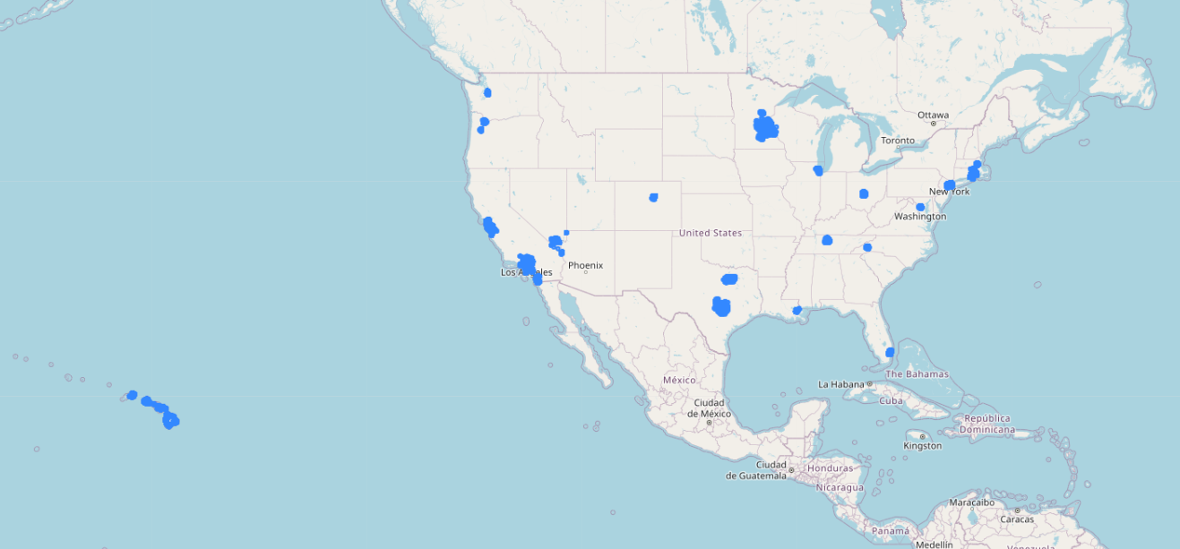
Airbnb Location Data
Airbnbs
262204
Neighbourhoods
1575
Airbnbs per Host
2
States
19
Cities
31

Slide 4
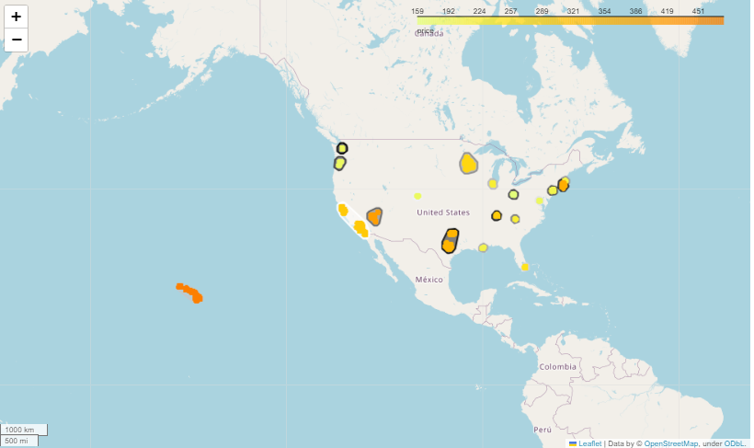
Analysis by State
Most Expensive
Hawaii
Cheapest
Ohio
More Airbnbs
California
Less Airbnbs per Host
Oregon
More Airbnbs per Host
Hawaii
Shortest Minimum Stay
North Carolina
Longest Minimum Stay
Massachussets

Slide 5
Host Insights
The top 3000 hosts:
Account for 49.95 % of the profits;
Run 26.25 % of the Airbnbs;
Represent 2.28 % of all the hosts;
Have, on average, 23 Airbnbs each.
Most Common Prefered State
California
Most Common Prefered City
Los Angeles
Average Minimum Stay
11 nights

Slide 6
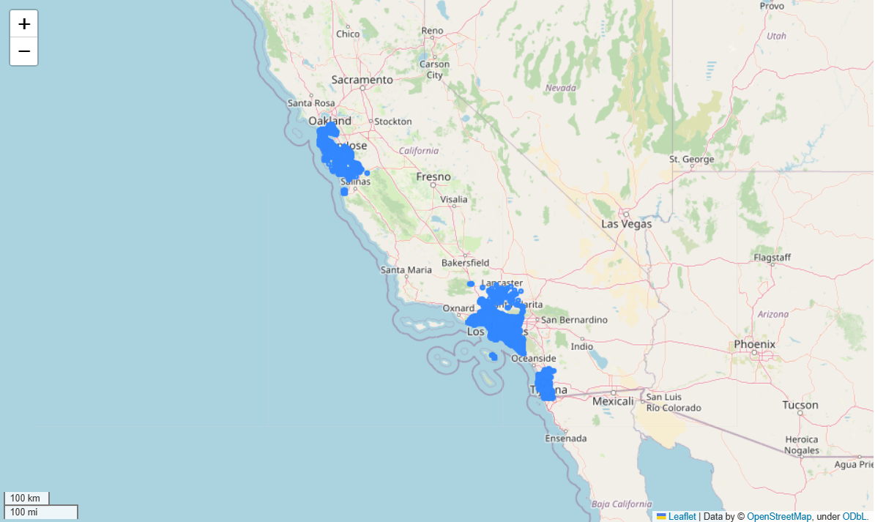
Airbnbs in California

Slide 7
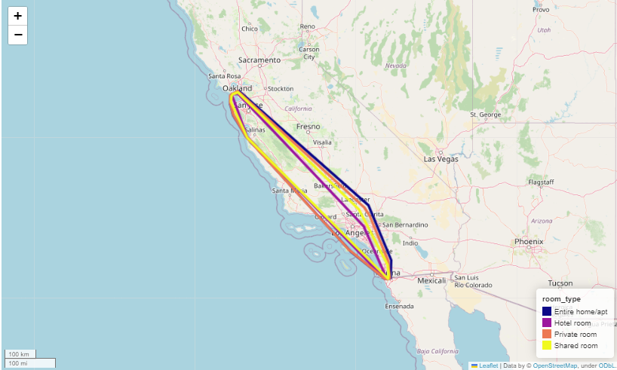
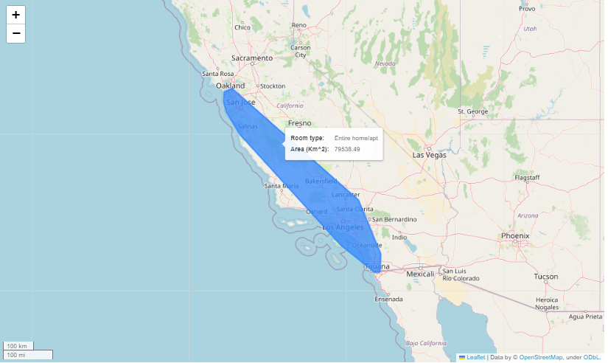
Determining the geographical boundary encompassing all the listings of each room-type? Which boundary has the biggest area?
On the left, we can see the outlines of 4 polygons, each containing all rooms of a respective room type. The Polygon with the largest area is the one containing rooms of type ‘Entire home/apt’ with an area of 79538 Km², this polygon can be seen individually on the right.

Slide 8
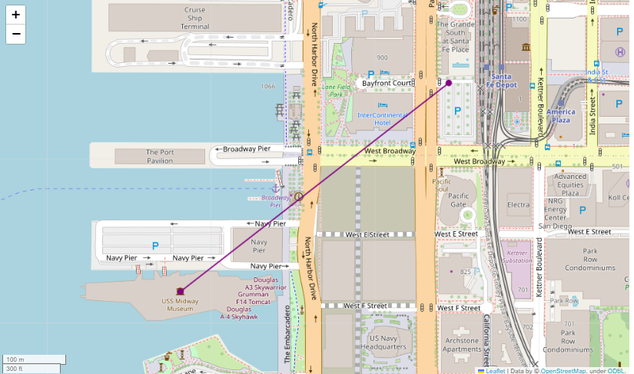
Closest “Private Room” to the USS Midway
Room_id
555617206
Distance to the USS Midway
533 meters

Slide 9
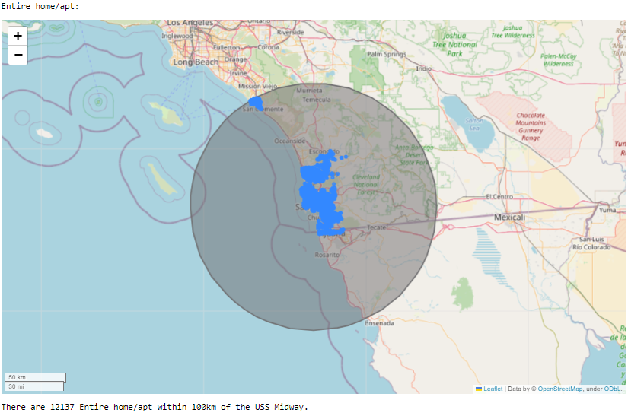

Type of Rooms within 100 km of the USS Midway
Entire home/apt
12137
Private Room
2164

Slide 10
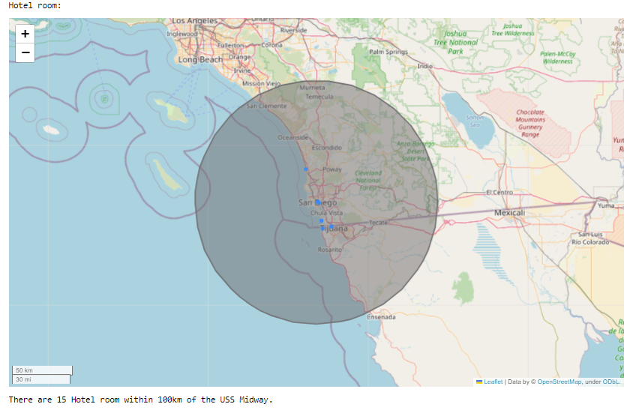
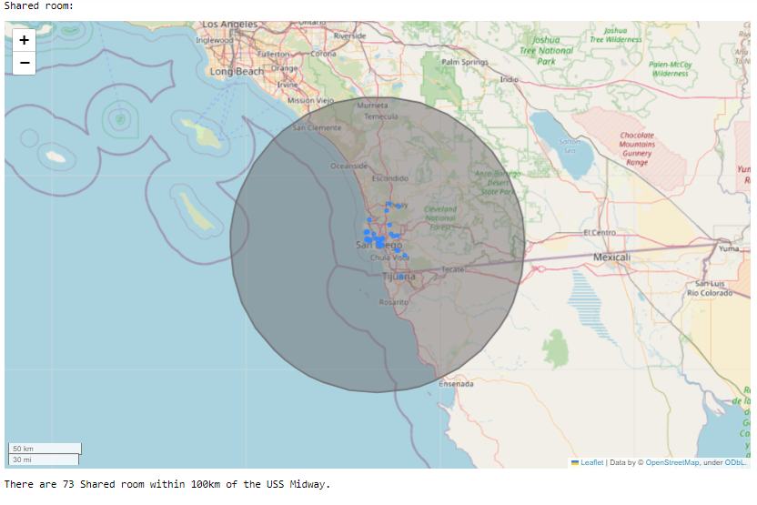
Type of Rooms within 100 km of the USS Midway
Hotel Room
15
Shared Room
73

Slide 11




Data Integration
Airbnb Location Data
Gun Crime Data
TripAdvisor Museum Data
Population Data

Slide 12
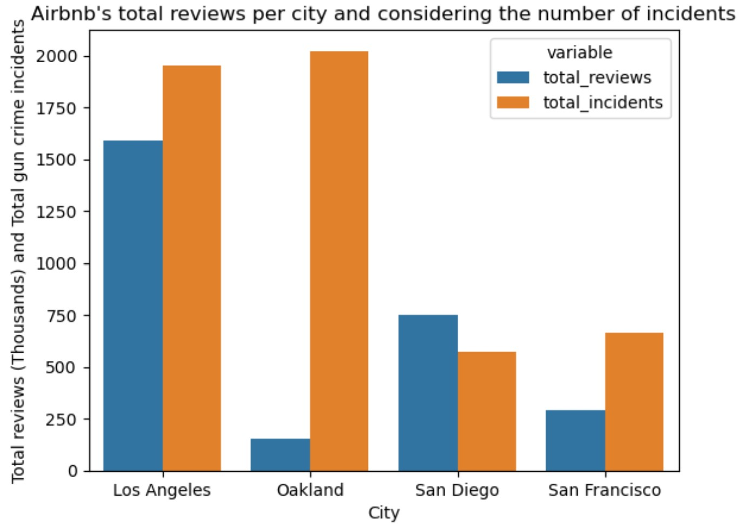
Airbnb Location Data + Gun Crime Data
Within the state of California, is there a relationship between the number of reviews (hence the number of stays) on a specific location/city and the amount of gun crimes reported in the area?
Notes:
Los Angeles have a high number of reviews and a high number of gun crimes incidents.
Compared to Los Angeles, San Diego and San Francisco have considerably less reviews but also considerably less crimes.
Oakland; however, has less airbnb reviews that the previous three, but even more gun
crimes that the big city of Los Angeles.
Final conclusion: There is almost correlation between the number of gun crimes and the number of reviews in airbnbs of California.

Slide 13
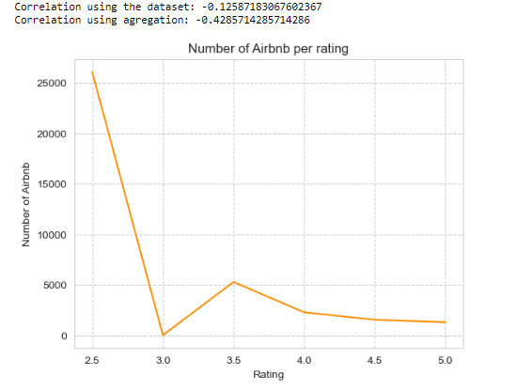
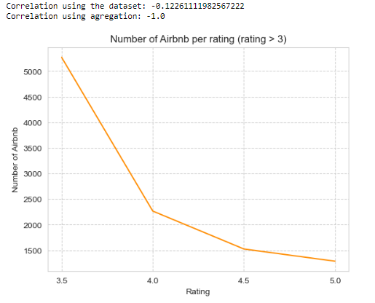
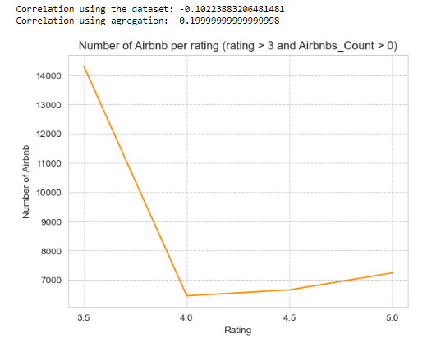
Airbnb Location Data + TripAdvisor Museum Data
Is there a relationship between the Rating on TripAdvisor of a museum and the number of Airbnb rooms to stay within a radius of 10 km?
Museums with all ratings.
Museums with rating greater than 3.
Museums with rating greater than 3 and Airbnbs within a 10km radius.
Conclusion: Higher-rated museums tend to have fewer nearby Airbnb listings.

Slide 14
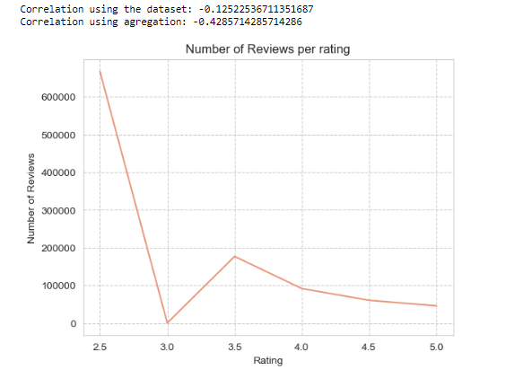
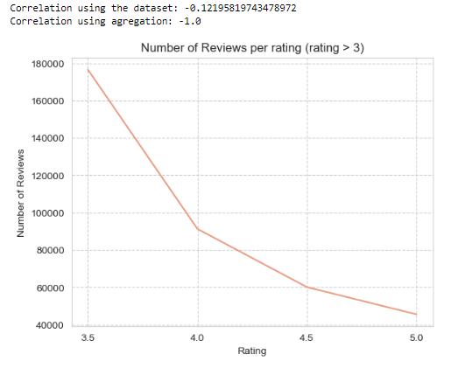
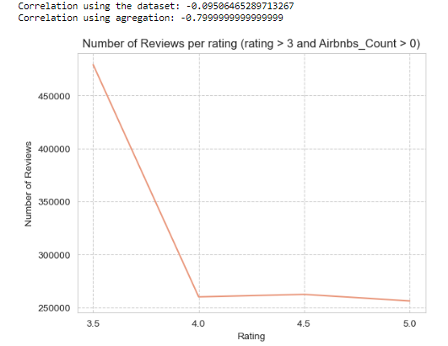
Airbnb Location Data + TripAdvisor Museum Data
Is there a relationship between the Rating on TripAdvisor of a museum and the number of reviews (hence the number of stays) of Airbnbs within a radius of 10 km?
Museums with all ratings.
Museums with rating greater than 3.
Museums with rating greater than 3 and Airbnbs within a 10km radius.
Conclusion: -Higher-rated museums tend to have fewer number of reviews in the Airbnb near the museums.
-There is a strong correlation between the number of Airbnbs nearby museums and the number of reviews in the Airbnb near the museums.

Slide 15
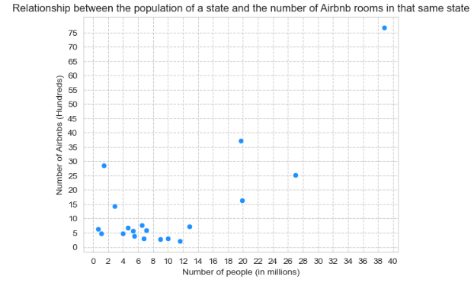
Airbnb Location Data + US Population Data
Is there any relationship between the population of a state and the the amount of Airbnb listings in that state?
Conclusion: in general, the higher the state's population, the greater the amount of Airbnb listings in that state.

Slide 16


Suggestions for Airbnb
Target states with lower representation (Ohio).
Record information on each stay.
Expand the dataset geographically.
Collaborate with museums.
Analyse in more detail what differentiates the top hosts from the others.
Increase Profitability
Attract a more diverse customer base

Slide 17

Thank you!
Margarida Cruz | 20221929
João Capitão | 20221863
Luis Mendes | 20221949
Dinis Gaspar | 20221869

